Slide 1
Dental Carries
Student’s Name
University Department
Course Name/Number
Professor’s Name
Date

Slide 2
Introduction
Dental carriers is a major global health issue
It mainly affects children population
It is also a major concern in the United States
The government has responded to this issue by;
Increasing the dental coverage for children through the Affordable Care Act of 2010 (Gupta, 2018)
This presentation examines key features of dental carriers such as:
Historical antecedents, epidemiology, prevalence among other issues
Notes:
Dental carries has become a major health issue in the United States and worldwide. Research shows that dental carriers affect children population the most. However, this does not mean that the adults are spared. The government’s response to this issue include increased dental coverage through the Affordable Care Act of 2010. This presentation will discuss key factors in dental carries including historical antecedents, epidemiology, prevalence, and world’s response to the issue.

Slide 3
Definitions
Dental carries is a chronic disease, which results in the destruction of dental hard-cellular tissue through bacterial fermentation of sugar (Yadav & Prakash, 2017)
Dental carries is a multifactorial disease that comprises of complex risk and protective factors (Young et al., 2015)
It can also be understood as;
A post-eruptive bacterial infection that is characterized by progressive demineralization process (Veiga et al., 2016)
All agree that dental carries is a chronic disease
Notes:
Different definitions have been offered towards understanding the concept of dental carries. Literature agree one factor that is constant across the definitions that we have examined above. Every research study identify dental carries with chronic conditions citing that it can result in serious health risks if not controlled. According to Viega et al. (2016), dental carries are known to cause high rate of morbidity among population. It is also associated with reduced quality life (Veiga et al., 2016).

Slide 4
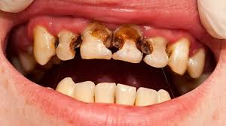
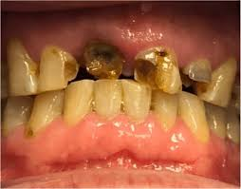
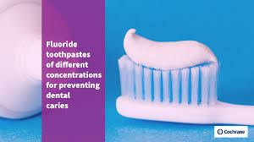
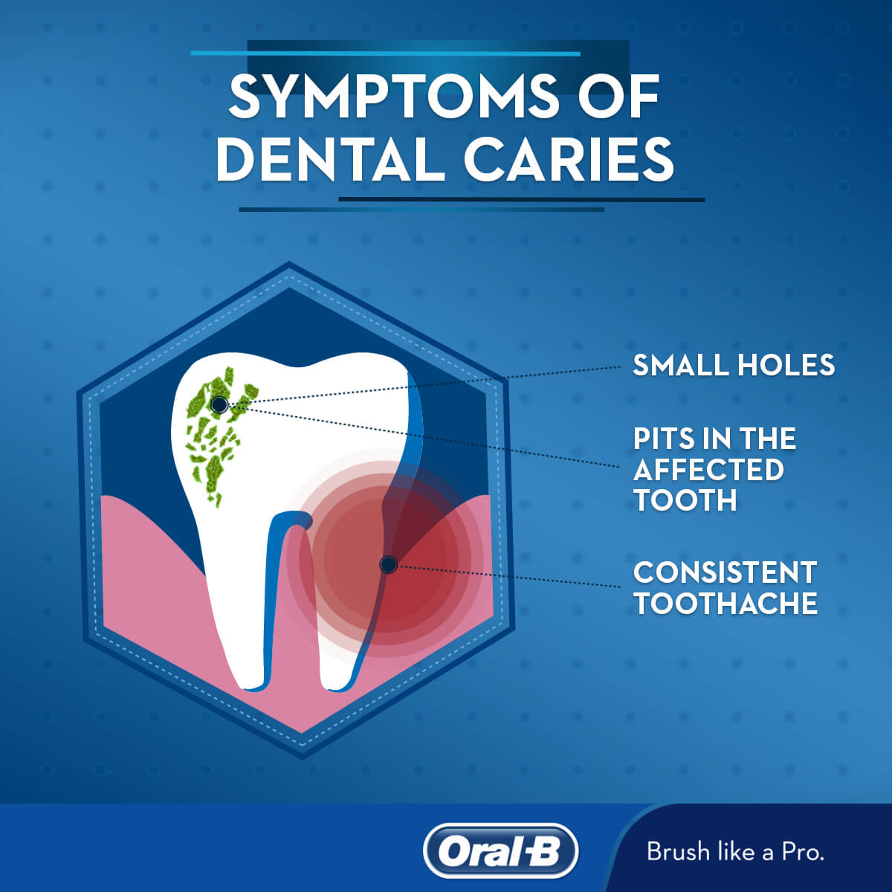
Dental Carries
Notes:
Dental carries is a serious problem. As shown in the photos above, one cannot imagine the impacts associated with having a teeth like the ones shown. Research has shown that dental carries are associated with socioeconomic, demographic conditions, and behavioral aspects of a population (Viega et al., 2016). Dental carries takes away the pride of smiling, which may increase stress and anxiety levels of such people. All these can further expose the individual to more health risks.

Slide 5
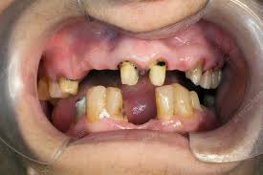
Historical Antecedents
Dental carries have existed since the beginning of human civilization
However, little research exist on complex dental carries
Vast knowledge that exist involves basic concepts of dental carries (Ferreira Zandoná et al., 2012)
Notes:
There is no specific historical study that shows that dental carries started at a particular period. However, the currently existing knowledge involves only basic concepts about this condition (Ferreira Zandoná et al., 2012). The above photos shows some of the cases of dental carries and their impacts on an individual’s teeth. Dental carries are obviously taking away the pride of many people who suffer from this condition.

Slide 6
Continuation of Historical Antecedents
Dental carries studies have highlighted the role of diet consideration
The impact of dietary resources have also been linked to the history of this condition (Grimoud et al., 2011)
Carbohydrates have been identified as the main risk and causing factor (Grimoud et al., 2011)
Other possible factors include hygiene practices, oral environment, food quality, and time factor
Dental carious process involves a lot of factors
Notes:
Research studies have indicated that dental carries is a problem that begins in childhood and grows into something serious as one grows up. Grimoud et al. (2011) assert that observations around the aetiology of this condition have identified the critical role played by carbohydrates, with sugar content as the main causing factor of dental carries. However, research has also pointed out some other possible factors including the oral environment, hygiene practices, and quality of food consumed.

Slide 7
Continuation of Historical Antecedents
Dental carries did not receive much attention before
It emerged during the urbanization and industrialization as a major disease (Frazão, 2012)
The expansion of sugar consumption in 16th and 17th centuries
Increased epidemic levels after this period
Growing perception of illness were linked to this oral health issue (Frazão, 2012)
Monitoring techniques were established in the 1930s (Frazão, 2012)
Dental carries became a major health concern
Notes:
Even though people had decayed teeth, but it did not receive much attention until 19th century when measures to monitor the distribution of conditions. As Frazão (2012) further explains, first studies on dental carries epidemiology were published in the 1930s. These studies pointed out that dental carries may have started during the industrialization in the 16th century when sugar consumption tremendously increased.

Slide 8

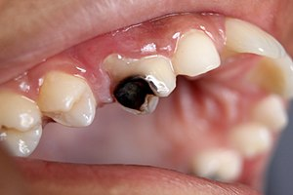
Epidemiology
Dental carries involves demineralization of the hard dental tissues (Frazão, 2012)
Begins within the bacterial biofilm that cover the tooth surface (Gomez, 2013)
Exposure of sugar diets can cause the bacterial biofilm
Notes:
According to Frazão (2012), the microbe communities play a significant role in attaching the tooth to the surface or gum. However, sugary content food can affect this connection with coating of bacteria on the surface. The development of bacterial biofilm begins with pellicle formation. Pellicle formation is shown on the two photos shown above. The bacteria affects the pellicle-coated surface and with time it creates a cariogenic environment on the tooth surface (Gomez, 2013).

Slide 9
Prevalence
Studies show that dental carries is prevalent among children population
Prevalence rate has increased significantly.
Studies shows increment in prevalence from 24% to 28% between 1988 and 1999 (Rozier et al., 2017)
Average 2.15 tooth surfaces of every child were affected between the same period.
The average rate has increased from 2.15 to 2.58 between 2011 and 2012 (Rozier et al., 2017)
About 9% of children have experienced dental carriers (Rozier et al., 2017)
Notes:
Studies have shown that dental carries in the United States has been more prevalent among children population. According to Rozier et al. (2017), about 9% of American children suffer from this condition. Tafere et al. (2018) explain that more than 60% of children and about 100% of adults have dental cavities. The problem is not only in the United States, but worldwide.

Slide 10



Relevance of Study
Dental carries contributes to discomfort and pain (Tafere et al., 2018)
Studies further shows that there is a direct link between oral heath and overall health (Gupta et al., 2018)
This study advances oral hygiene practices and dental care programs
Notes:
No one can bear the pain and cost associated with dental carries. This study has shown the statistics of dental carries and the level of damage it can cause to people. This study is relevant not only to the members of the public, but the findings can also contribute in understanding the need for dental care programs in the health care system. To the members of the public, this study is important because it points out the critical role of ensuring oral hygiene. Tafere et al. (2018) explain that despite that dental carries affect huge population, little has been done to consider it a great threat. Therefore, this is a responsibility that begins with individual people. Everyone must take care of their oral hygiene to avoid the pain and cost associated with dental carries.

Slide 11



Scientific Advancements
Existence of wide range of epidemiological data
Robot assistance surgeries
Artificial intelligence
And teeth regrowing
Notes:
Some of the key scientific advancements that have significantly assisted to deal with the dental carries problem include the robot surgery assistant as shown in the first picture. The first robot-led dental surgery was done in China in 2017 where a robot was used to perform two dental implants. Another advancement is the artificial intelligence, which provide virtual assistance. This will reduce the cost and time in dental carries care. Regrowing teeth is another advancement that has been used to help bring back the smile pride in people that have had damaged teeth.

Slide 12
World’s Response to Dental Carries
World’s response to dental carries include:
Raising awareness campaign through the international organizations like WHO
Increased taxation of sugar-content foods and beverages
Implementing clear nutritional guidelines
Individual government response to the issue include:
Setting policies and programs to help deal with it
In the U.S. the government increased the dental coverage for children through ACA of 2010.
Notes:
The World Health Organization has been working closely together with the individual countries across the world to ensure that dental carries problems are reduced or eradicated. Some of the measures include raising awareness through media campaigns on the dangers of sweetened food products, increased taxation of these products, and setting clear nutritional guidelines and labeling (WHO, 2017).

Slide 13
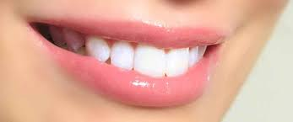
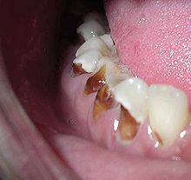

Personal Opinion
I personally think that dental carriers:
Have denied many people the opportunity to interact and socialize freely because they don’t feel comfortable
I also think that serious measures need to be taken
This includes ensuring personal oral hygiene from childhood
Notes:
This presentation has presented us with several facts regarding dental carries. It is clear now that dental carries is a health problem but it has been widely ignored either in the policymaking and studies. No one would want to keep themselves off from smiling or laughing when in a conversation with colleagues. Therefore, I believe that dental carries have denied many people a great opportunity to express themselves through smile and laughter.

Slide 14
Recommendations
Reduce the dental cost for dental carries treatment
Increase budgetary allocation for dental carries programs
Encourage free sugar food content or dietary guidelines
Increase awareness and access to quality food
Improve food environment
Regulate sales of high-sugar content foods and beverages
Practice oral hygiene
Notes:
Several studies have recommended the measures that can be taken to ensure that dental carries is limited since it affects a greater percentage of the world population. The above are some of the measures that I recommend to help alleviate this problem. These measures can be implemented by the implemented by both the institutions and individual people. Foe example, no one should wait the government to come and tell them that it is important to brush teeth after every meal. This is an individual responsibility that begins at home.

Slide 15
References
Ferreira Zandoná, A., Santiago, E., Eckert, G. J., Katz, B. P., Pereira de Oliveira, S., Capin, O. R., ... & Zero, D. T. (2012). The natural history of dental caries lesions: a 4-year observational study. Journal of dental research, 91(9), 841-846.
Frazão, P. (2012). Epidemiology of dental caries: when structure and context matter. Brazilian oral research, 26(SPE1), 108-114.
Gomez, G. F. (2013). Early childhood dental caries: a rising dental public health crisis. Contemporary Issues in Early Childhood, 14(2), 191-194.
Grimoud, A. M., Lucas, S., Sevin, A., Georges, P., Passarrius, O., & Duranthon, F. (2011). Frequency of dental caries in four historical populations from the Chalcolithic to the Middle Ages. International journal of dentistry, 2011.
Gupta, N., Vujicic, M., Yarbrough, C., & Harrison, B. (2018). Disparities in untreated caries among children and adults in the US, 2011–2014. BMC oral health, 18(1), 30.
Rozier, R. G., White, B. A., & Slade, G. D. (2017). Trends in oral diseases in the US population. Journal of Dental Education, 81(8), eS97-eS109.

Slide 16
Continuation of References
Tafere, Y., Chanie, S., Dessie, T., & Gedamu, H. (2018). Assessment of prevalence of dental caries and the associated factors among patients attending dental clinic in Debre Tabor general hospital: a hospital-based cross-sectional study. BMC oral health, 18(1), 119.
Veiga, N., Aires, D., & Douglas, F. (2016). Dental caries: A review. Journal of Dental and Oral Health, 3(1), 2.
WHO. (2017 November, 9). “Sugars and Dental Carries.” World Health Organization (Online). https://www.who.int/news-room/fact-sheets/detail/sugars-and-dental-caries
Yadav, K., & Prakash, S. (2017). Dental caries: A microbiological approach. J Clin Infect Dis Pract, 2(1), 1-15.
Young, D. A., Nový, B. B., Zeller, G. G., Hale, R., Hart, T. C., Truelove, E. L., ... & Kuehne, J. (2015). The American Dental Association caries classification system for clinical practice: a report of the American Dental Association Council on Scientific Affairs. The Journal of the American Dental Association, 146(2), 79-86.

